Slide 1
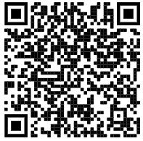

+++ Live +++ +++ Live +++ +++ Live +++
Welcome
to
Software Engineering
Lesson WS2021/2022
Starting at 14:15
survey

Slide 2

+++ Live +++ +++ Live +++ +++ Live +++
The rule No1
Keep your camera on

Slide 3
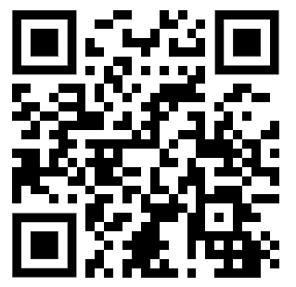
+++ Live +++ +++ Live +++ +++ Live +++
Software Engineering
WS-2020-2021
Lesson Mo. 14.15-17.45 h Lab: Tue. 14.00-16.00 h
Room 8-103
https://www.linkedin.com/groups/8689804/

Slide 4
Last Week
This Week

Slide 5
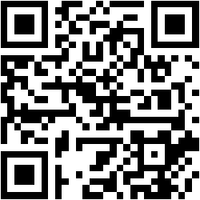
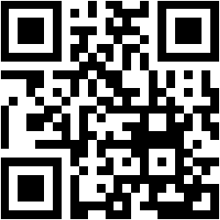
Packaging and Testing
Damir Dobric
Microsoft PTSP (Partner Technical Solution Specialist) Microsoft Most Valuable Professional
Blog
Twitter
damir.dobric@daenet.com b-dadobr@microsoft.com

Slide 6
Packaging

Slide 7


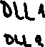


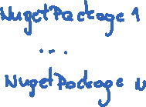
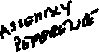
Referencing Libraries
Add reference to Project
Add reference to DLL
Add reference to Package
.nupkg
.nupkg

Slide 8
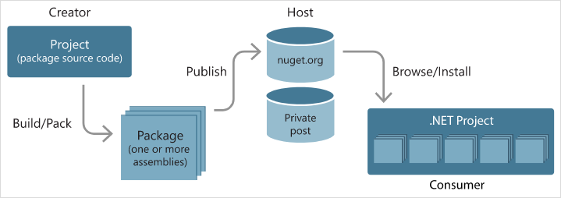
NUGET
Nuget is a tool for modern development
NuGet is the package manager for .NET
It is used to develop, share and consume libraries
https://docs.microsoft.com/en-us/nuget/what-is-nuget

Slide 9
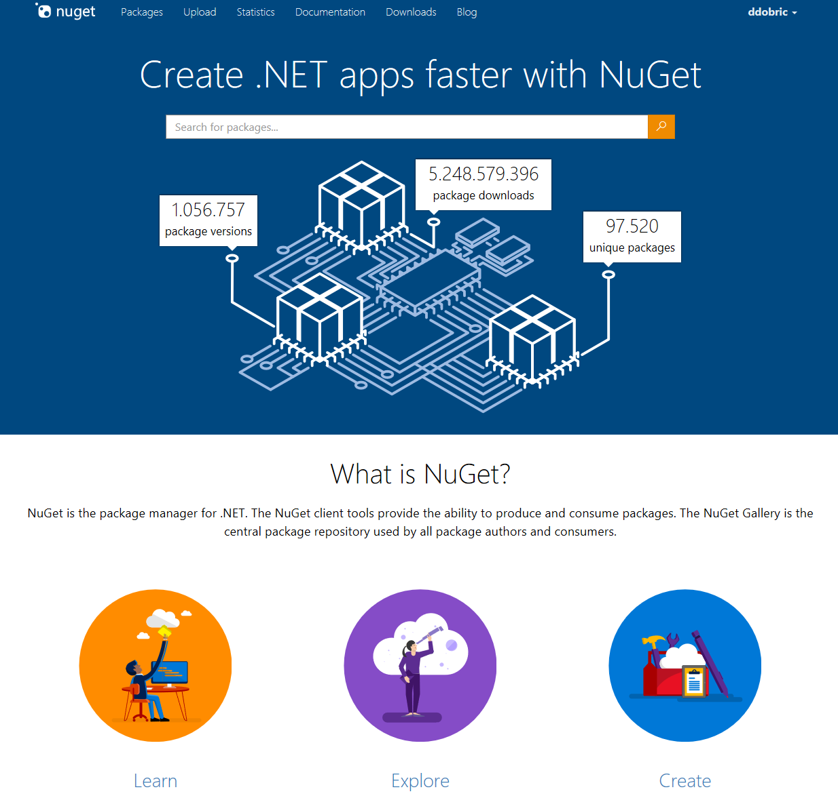
NUGET Gallery

Slide 10
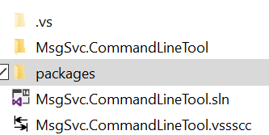
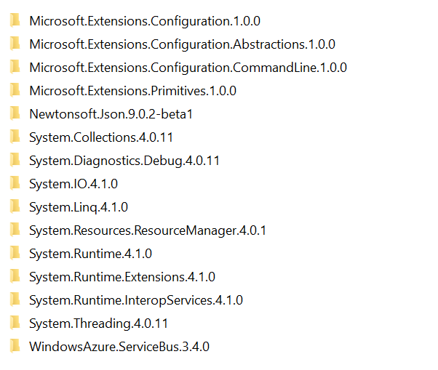
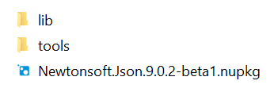
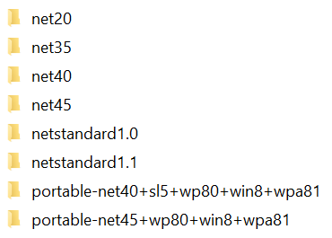








Behind NUGET package
Your packages are downloaded here
Your project
C:\Users\XY\.nuget\packages
Package contains builds for many platforms. Assemblies are always single platform build.

Slide 11
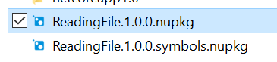
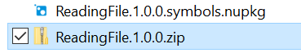
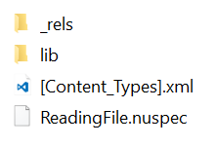



What is in the package?
Nuget is zip package
This is what you will see when you open it

Slide 12
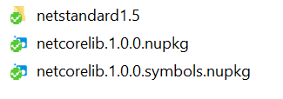
How to build NUGET package?
C:\AppFolder>dotnet pack –include-symbols
Required if building for debugging.
You will see build for all defined target frameworks
Command output is NUGET package
https://docs.microsoft.com/en-us/dotnet/core/tools/dotnet-pack?tabs=netcore2x

Slide 13
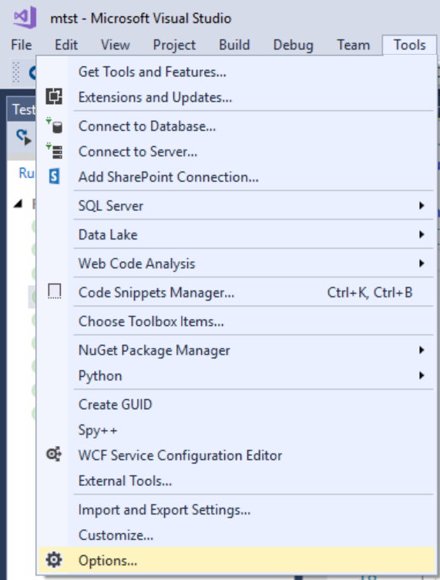
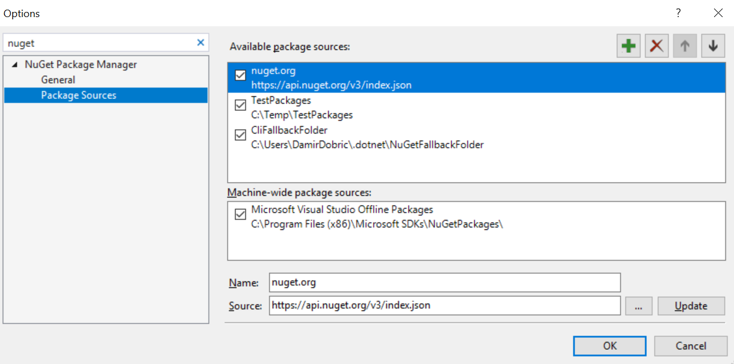
Adding NUGET source
After BUILD, NUGET has to be published
Publish to: NUGET.org, VS-Online Feed or File share

Slide 14
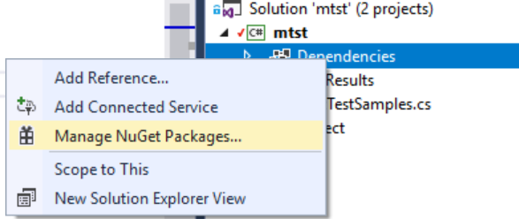
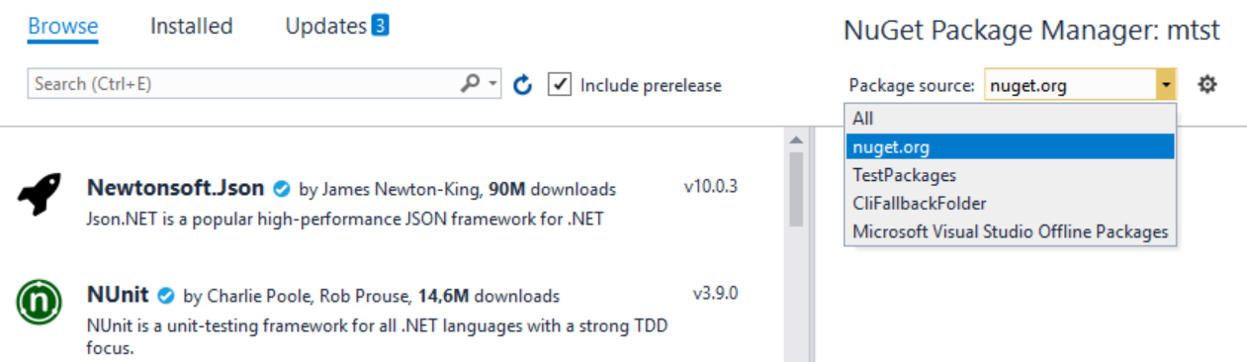
Adding NUGET package
Select project, go to dependencies and then “Manage Nuget Packages”
Here you can chose sources

Slide 15
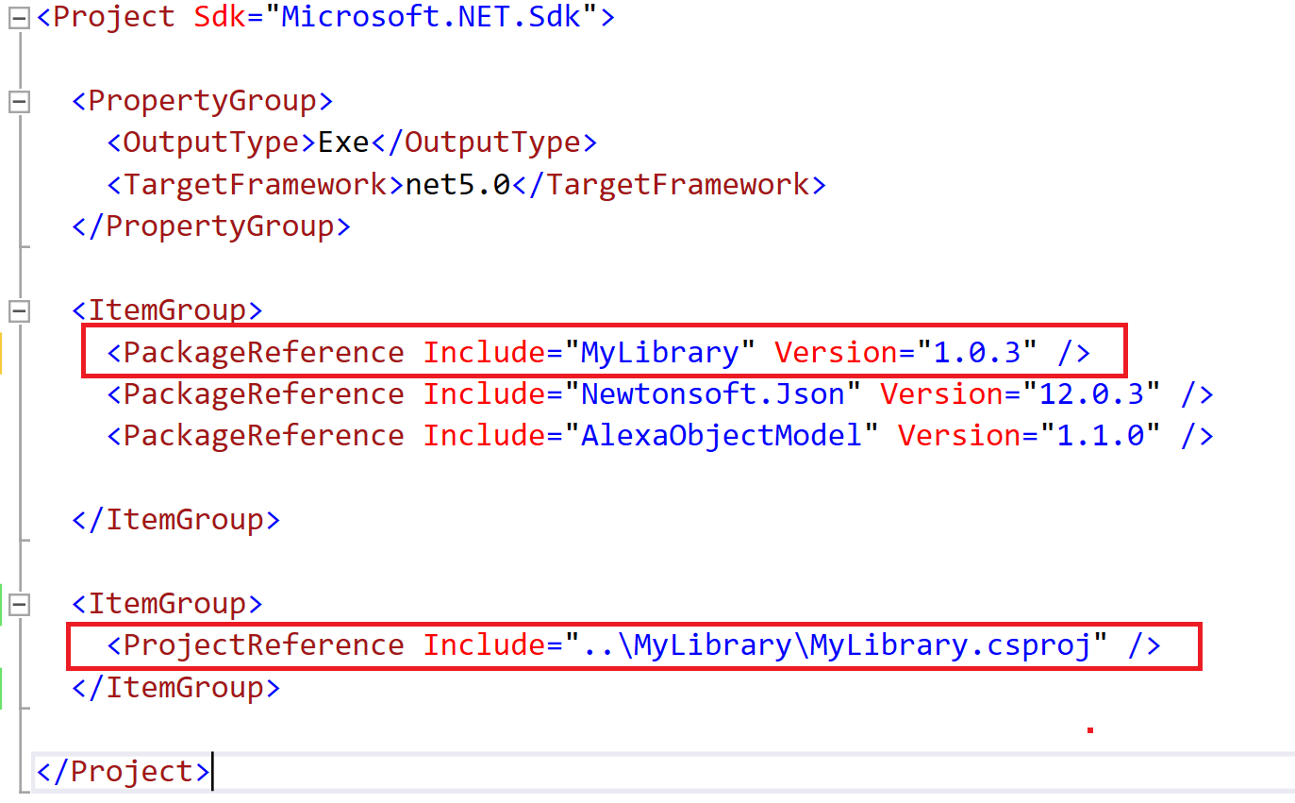
Referencing by NUGET and Project. Don't USE BOTH!

Slide 16
Testing
https://docs.microsoft.com/en-us/visualstudio/test/unit-test-your-code

Slide 17
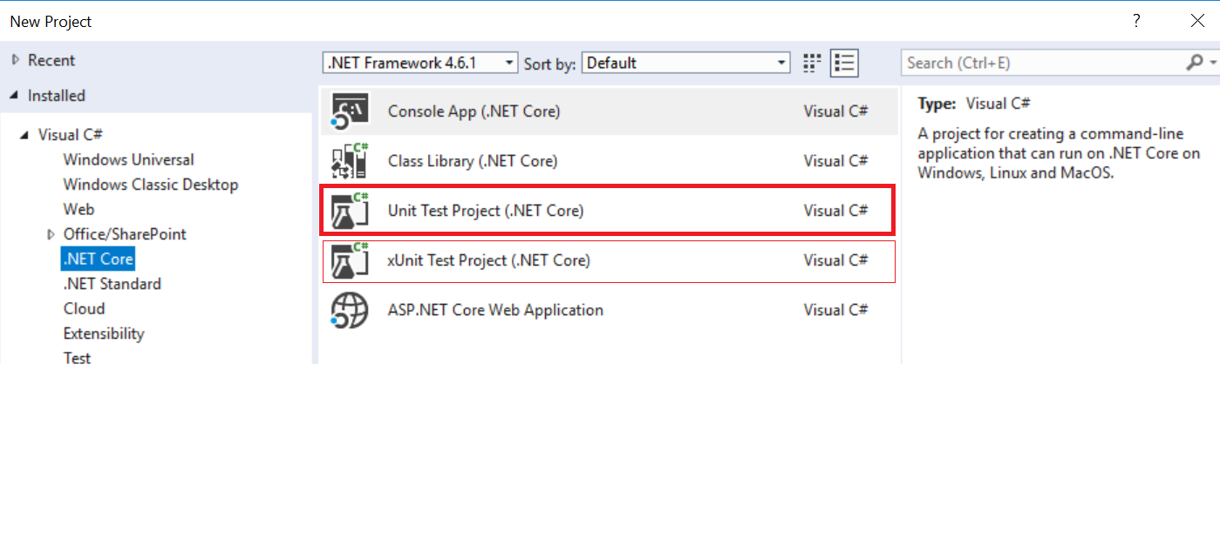
Create UnitTest Project in Visual Studio

Slide 18
Create UnitTest with dotnet CLI
>md mtst
>cd mtst
>dotnet new mstest

Slide 19
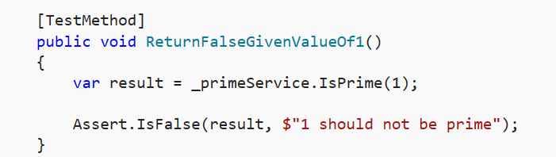
Unit testing with MSTest
Packages that activate UnitTests
<ItemGroup>
<PackageReference Include="Microsoft.NET.Test.Sdk" Version="15.0.0" />
<PackageReference Include="MSTest.TestAdapter" Version="1.1.11" />
<PackageReference Include="MSTest.TestFramework" Version="1.1.11" />
</ItemGroup>
[TestClass]
public class EncoderTests
{
[TestMethod] makes a class to appear as a visible Testing Method.
[TestClass] makes a class to appear as a visible Testing Class.
}

Slide 20
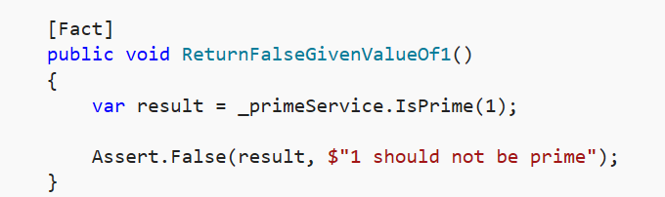
Unit testing with Xunit we will no more use xunit!
<ItemGroup>
<PackageReference Include="Microsoft.NET.Test.Sdk" Version="15.0.0" />
<PackageReference Include="xunit" Version="2.2.0" />
<PackageReference Include="xunit.runner.visualstudio" Version="2.2.0" />
</ItemGroup>

Slide 21
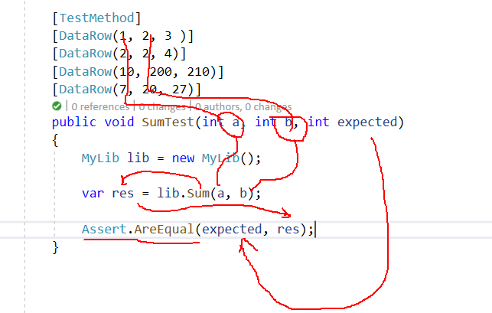
Using [DataRow] for multiple inputs
Use a single Unit Test with multiple input arguments.
Decorate the test method with the attribute [DataRow].

Slide 22
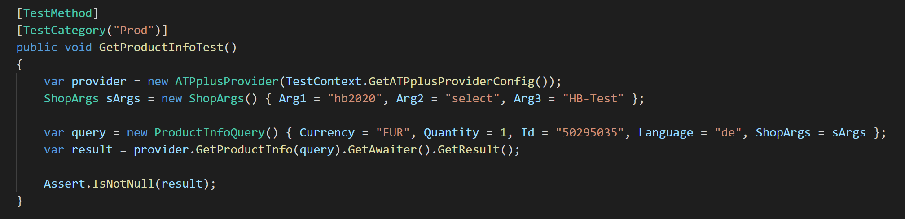
Test Categories
Every test can be tagged.
Tag is called category
Category groups together multiple tests
Test can be executed for specific categories only
Useful for automated testing and deployment (DevOps)

Slide 23
Test Execution
dotnet test -h
dotnet test --list-tests
Execute specific tests
dotnet test --filter "MessageOnly_LogsCorrectValues“
dotnet test --filter Message -v d
dotnet test --filter Message -v n
dotnet test --filter Message -v d
dotnet test --filter Message –filter ”Priority = 1”
dotnet test --filter TestCategory=Prod

Slide 24
Serialization

Slide 25
What is Serialization
The process of writing the object to a persistence store
Deserialization is the opposite process
Serialization of MyAlgorithm instance.
MyAlgorithm alg = new MyAlgorithm();
...
SampleSerializer ser = new SampleSerializer();
ser.Serialize(alg, "myalg.json");
DeSerialization of MyAlgorithm instance.
var alg2 = SampleSerializer.Deserialize<MyAlgorithm>("myalg.json");
se-cloud-2021-2022\Source\UniTestsngAndPackagingSample\HelloStudents.sln

Slide 26
Exersizes
E10 – Working with NUGET
E11 – Working with UnitTests

Slide 27
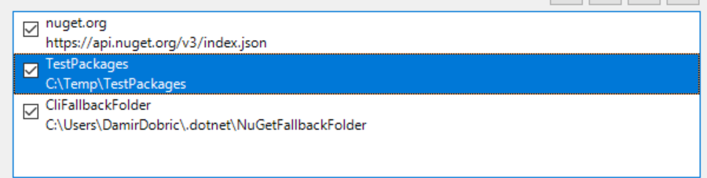
E10 – Working with NUGET
Go to VS settings and add new nuget source (file share)
Create new .NET Core Library (or use an existing one)
Open command prompt and navigate to project folder
Create NUGET package
Copy NUGET package to your nuget source folder. (c:\temp\TestPackages)
Open Visual Studio solution
Reference NUGE package from nuget source folder

Slide 28
E11 – Working with Unit Tests
The goal of this lab is to implement tests for your existing code
Create UnitTest Project in existing solution
Add reference from UnitTest project to your project
Implement Unit Tests

